Slide 1
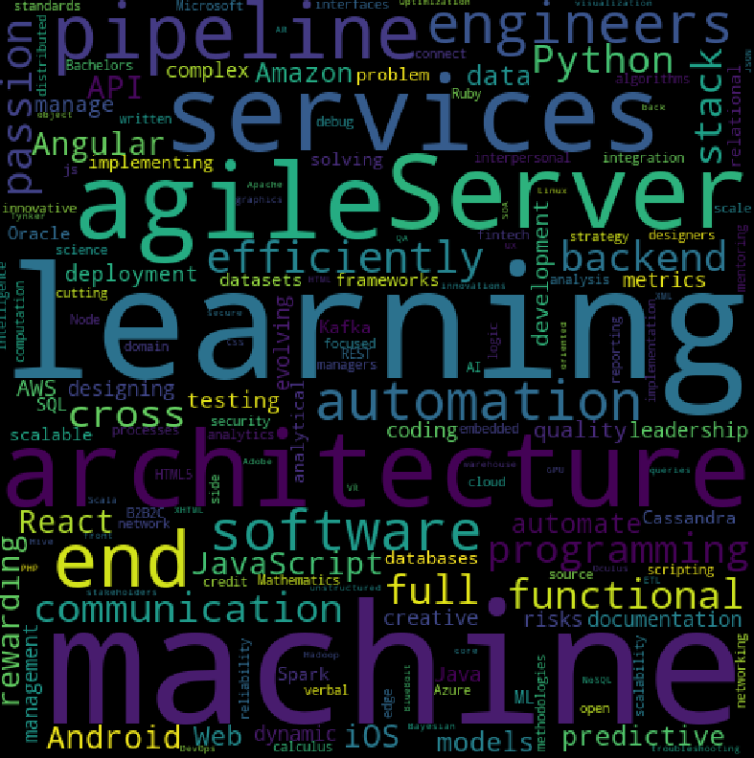
Skills and Jobs Match using NLP
Contributors: Bhumika Sharma
Cong Tran
Denis Cohen
Chris Janssen
Imran Bawany
Vijay Gangaprasad

Slide 2
Goal of Project
Help Job seekers to find how their skills stack up against the most sought after Machine Learning skills and tools and also recommend job postings that matches their skills reflected in their resume.
We focused on Machine Learning type job postings as the basis of the application but the functionality can extend to all types of postings.
We used NLP techniques to build our matching process with machine learning libraries in Python.

Slide 3
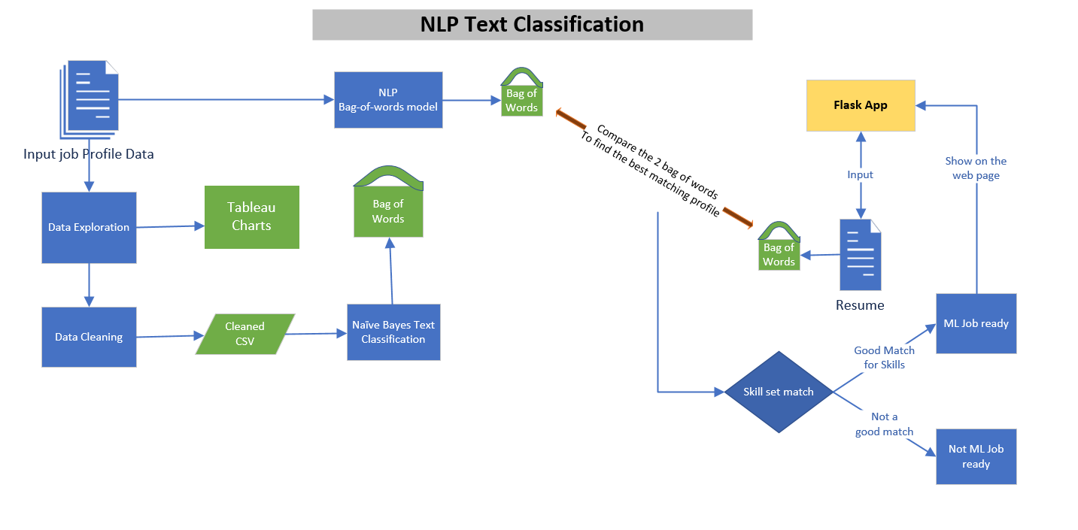

Slide 4
Data
Source
Exploration and Cleansing
Issues
Retrieved data set of job postings from Stack Overflow using the RSS Feed downloaded as an XML file and converted to a CSV.
Used Tableau to build chart to visualize the data. Visualizations included Job Title by Company, Job count by State, and Job count by Company. Data cleaning is done using Python libraries like Pandas.
The biggest issue was finding a dataset of current job postings. Many of the job posting websites (Indeed, Monster, etc) did not have an accessible API.

Slide 5
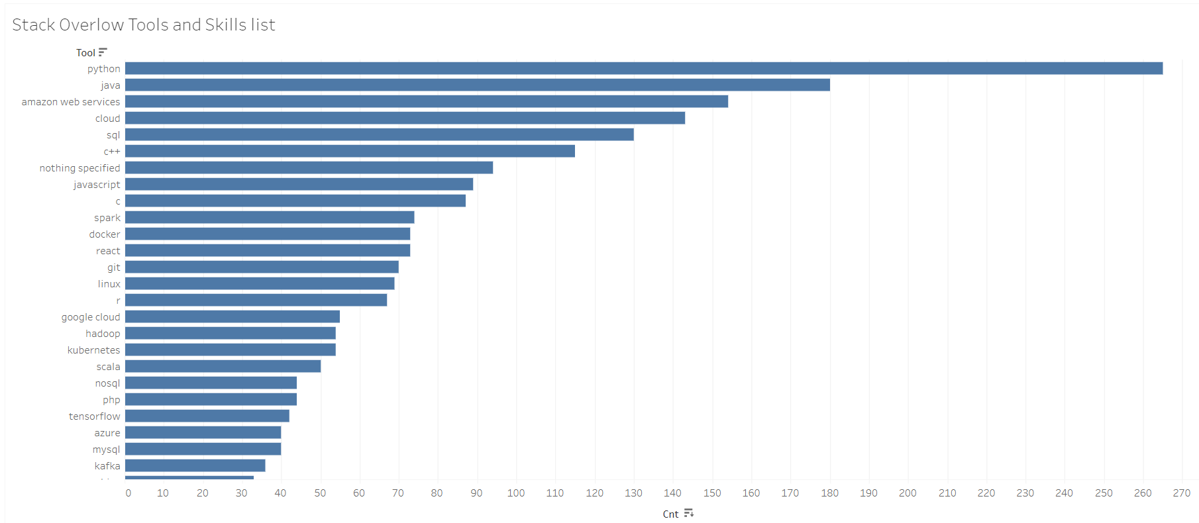
https://public.tableau.com/profile/vijaybabu.gangaprasad#!/vizhome/StackOverflowToolsandSkills/Sheet1

Slide 6
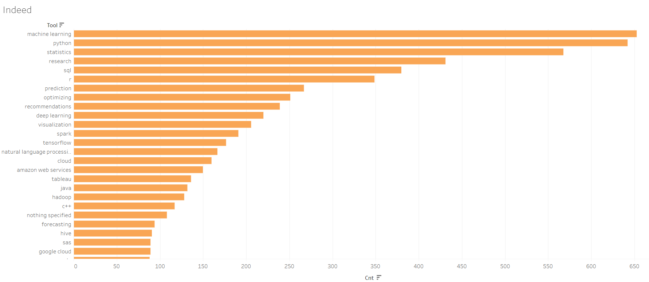
https://public.tableau.com/profile/vijaybabu.gangaprasad#!/vizhome/IndeedSkillsandtools/Indeed

Slide 7
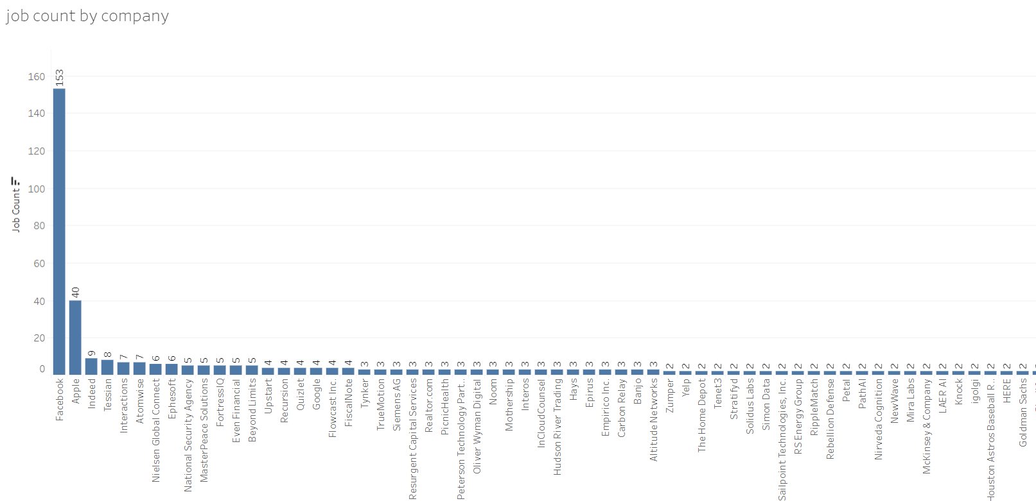
Visualizations: Job Count by Company

Slide 8
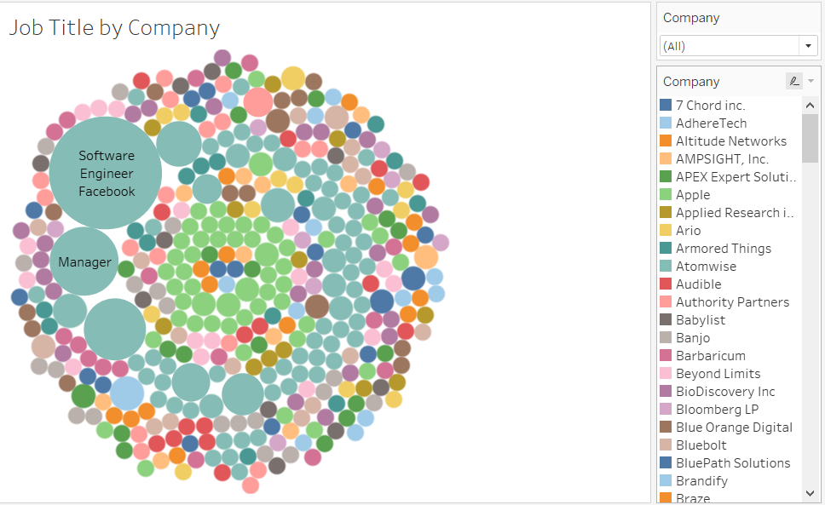
Visualizations: Job Title by Company

Slide 9
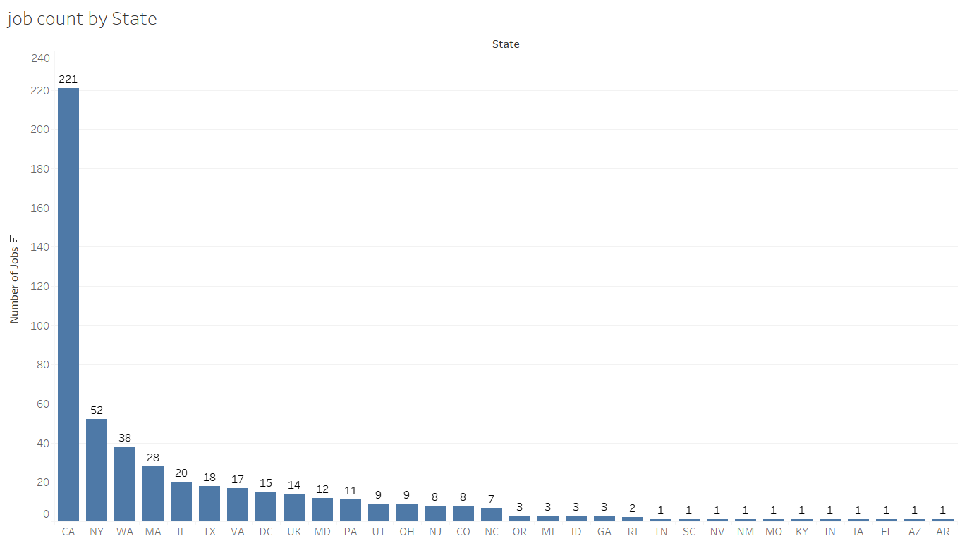
Visualizations: Job Count by State

Slide 10
Naive Bayes Classifier for Text Classification
Naive Bayes classifiers, a family of classifiers that are based on the popular Bayes’ probability theorem, are known for creating simple yet well performing models, especially in the fields of document classification and disease prediction.Naive Bayes classifiers are linear classifiers that are known for being simple yet very efficient.
In our case,the algorithm is applied to classify the job listing as either ‘Machine Learning’ or not.
Steps:
Data collection :StackOverflow job listings,data exploration, cleaning
Create all the features to the data set:Labeling,Tokenization,Stemming,stopword removal,Hashing TF,IDF
Naive Bayes model and fit training data
Transform the model with the testing data
Evaluation
Prediction

Slide 11
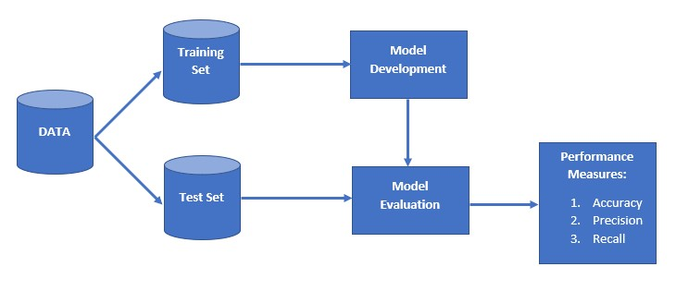
Naive Bayes Classification Workflow
Terms:
Tokenization:general process of breaking down a text corpus into individual elements
Stemming:process of transforming a word into its root form
Stop Words:words that are particularly common in a text but rather un-informative (e.g., words such as so, and, or, the, …”)
Bag of Words:a collection of words from a text with word count and disregarding the order in which they appear
TF(Term Frequency):number of times a word appears in a document divided by total number of words in the document
IDF(inverse document frequency):measures how important a term is.
IDF(t) = log_e(Total number of documents / Number of documents with term t in it)
Data Pipeline:data processing elements connected in series, where the output of one element is the input of the next one

Slide 12
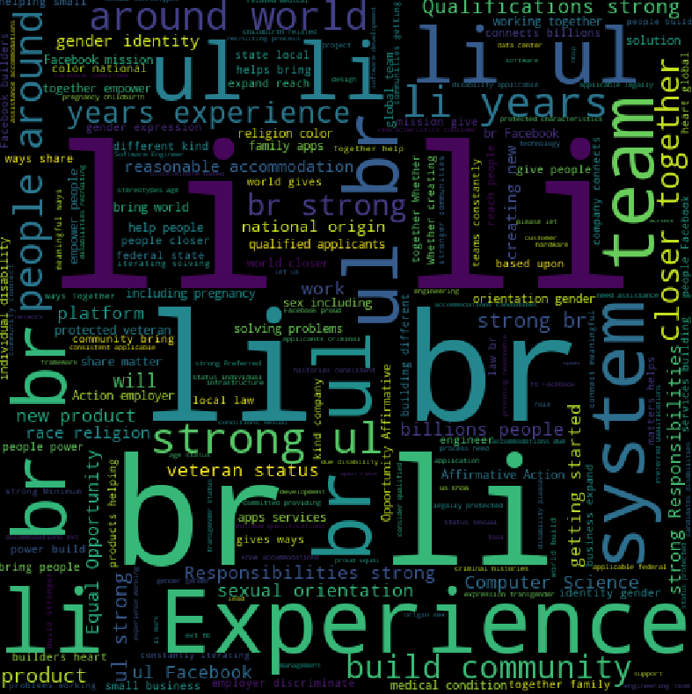
Word Cloud:Words Before Cleanup

Slide 13
Word Cloud: Machine Learning Focus

Slide 14
Process for App
Design --->
Flask App --->
Hosting
Used NLP techniques to design application using Python to match the keywords from user input resume to match with the keywords in the corpus of job postings. The application was based on the ranking results of TF-IDF.
Built Flask App to serve our application and created a user interface with HTML to allow the user to enter their resume as text. The application is then able to run the resume through the NLP model to create the match.
Used AWS to host the server and datasets in S3 buckets. We are able to launch the application in the cloud through AWS.

Slide 15
Programs/Libraries/Languages/Services Used
Python
Flask App
HTML
Pandas
NLTK
Gensim
AWS
Tableau
Scikit-Learn
Matplotlib
WordCloud
Numpy
Math

Slide 16
Demo of Resume and Job Posting Application

Slide 17
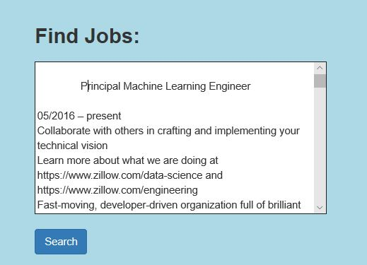

Slide 18
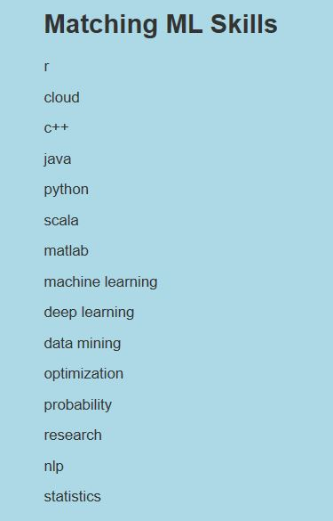
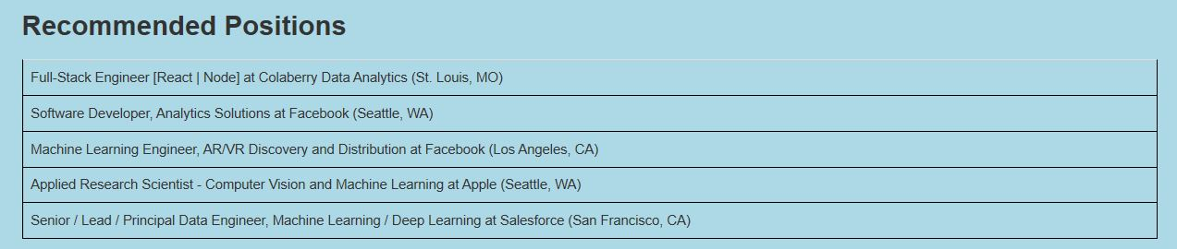

Slide 19
Github
Please visit our Github repository to see code and other resources:
https://github.com/vgangaprasad/ML_Skills_Match

Slide 20
Questions?

